Slide 1

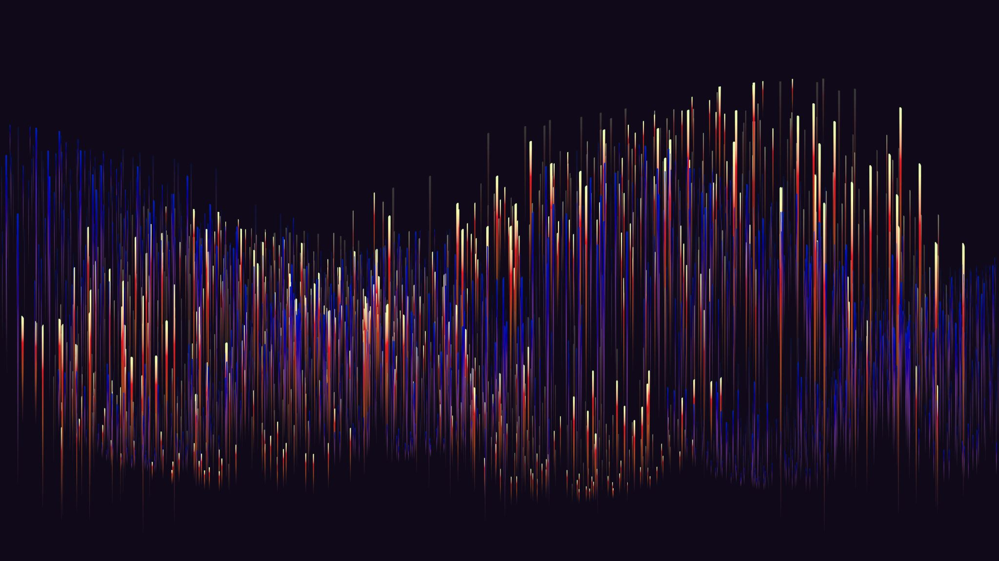
Timbre

Slide 2
Timbre
ANSI (1960)+ Plomp (1970): "that attribute of sensation in terms of which a listener can judge that two steady complex tones having the same loudness, pitch and duration are dissimilar“
Houtsma (1989): These properties include the sound's spectral power distribution; its temporal envelope . . . rate and depth of amplitude or frequency modulation, and the dregree of inharmonicity of its partials. The timbre of a sound therefore depends on many physical variables."
Tone colour, texture, quality
Highly multi-dimensional sensation
spectrum
timbre
time
timbre
Waveform
shape
timbre

Slide 3
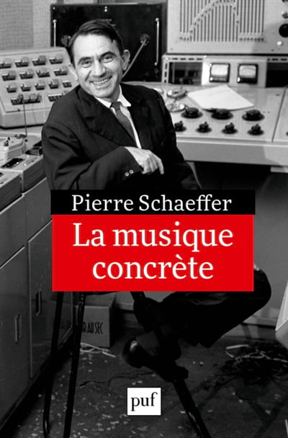
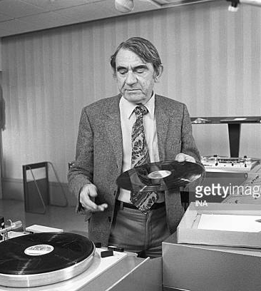
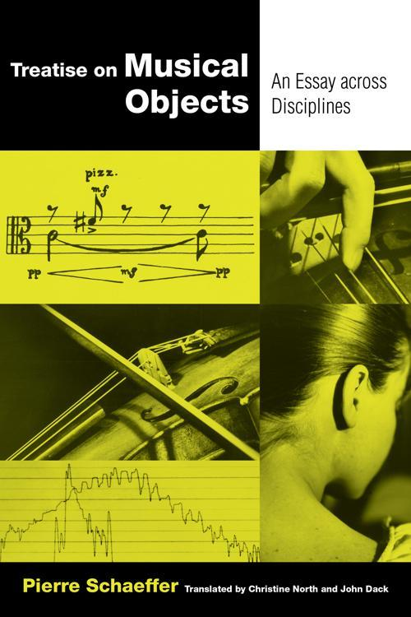
2 different listening modes: Default (source-based) Reduced (acousmatic, sound qualities)

Slide 4
Defining attributes of timbre Schouten (1968)
The range between tonal and noiselike character
The spectral envelope
The amplitude envelope in terms of rise, duration and decay
The change both of spectral envelope (formant glide) or fundamental frequency micro­intonation)
The prefix: an onset of a sound quite dissimilar to the ensuing lasting vibration

Slide 5
Timbre = Spectrum?
Why don’t they yield realistic sounds?

Slide 6
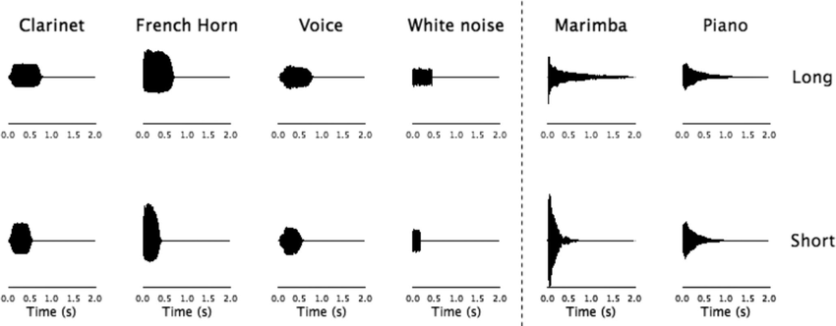
Envelopes: the temporal factor
First 13 partials of a Trumpet
Envelopes: functions representing the temporal evolution of partials, overall amplitude, etc

Slide 7
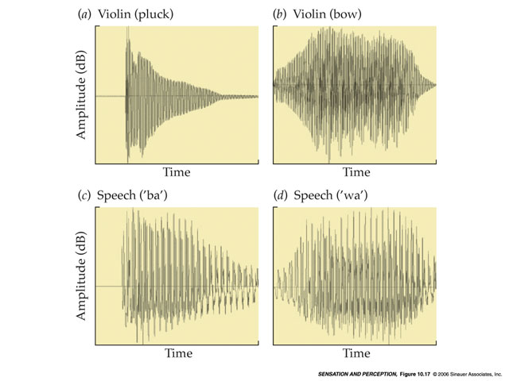
The attack
Believed to convey most of the source information
Noisy character in some instruments
Different attacks change the timbre sensation…
… but not necessary the source name -> invariant perception of source

Slide 8
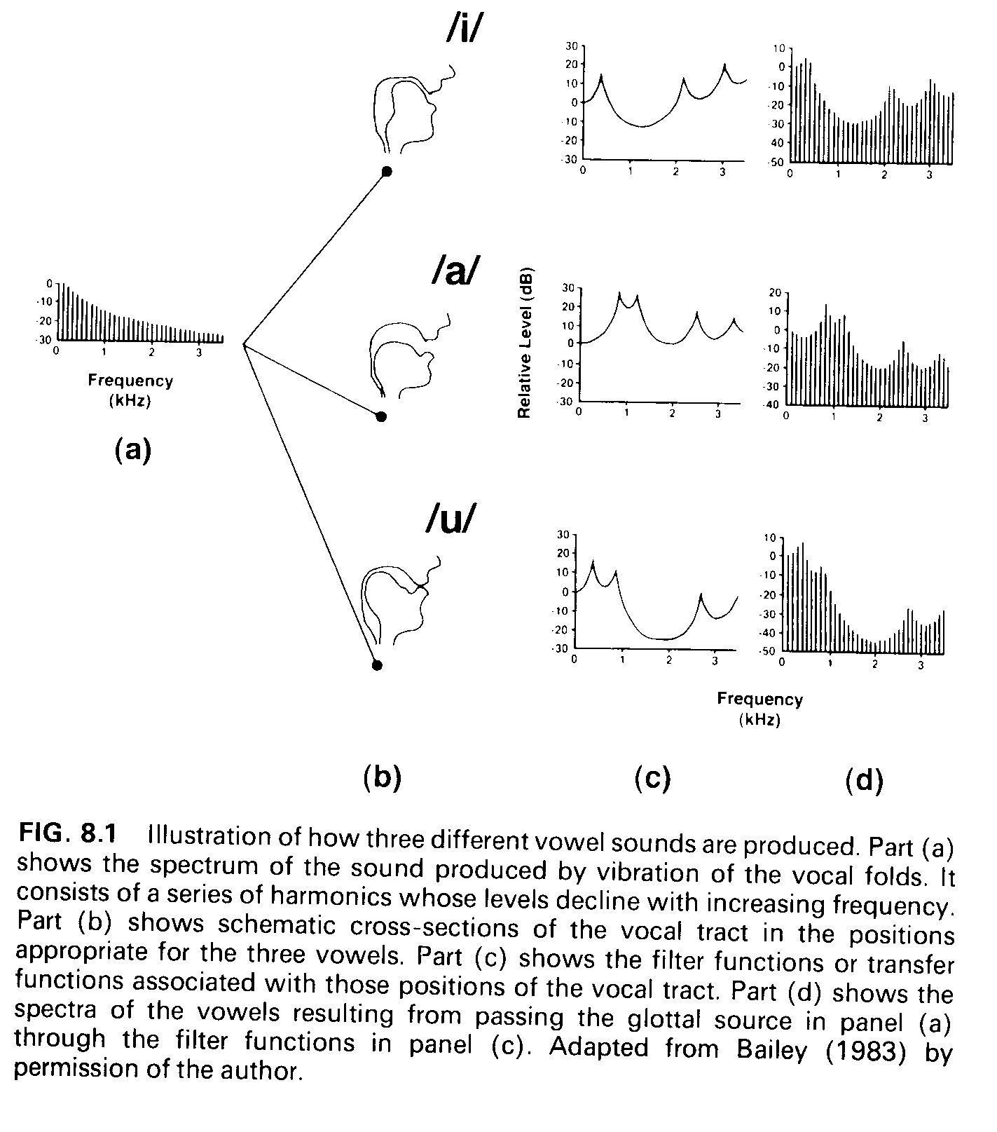
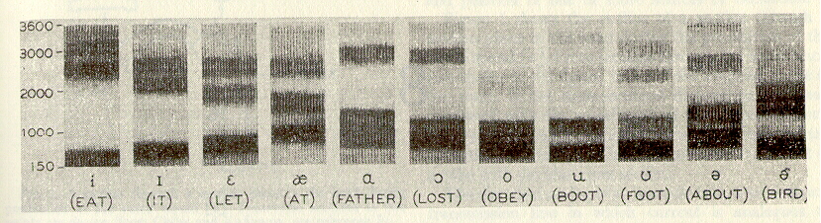
Formants
Spectral regions of high-energy, that impart distinctive characteristics to the sounds

Slide 9
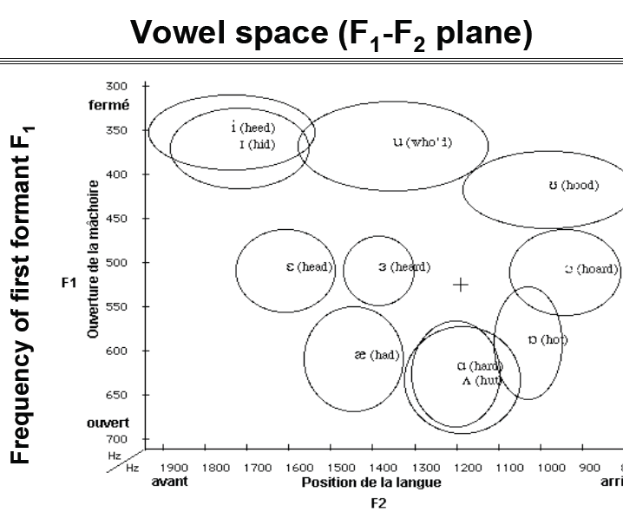
Formants
Two formants can be enough to identify different classes of sounds (e.g. vowels)

Slide 10
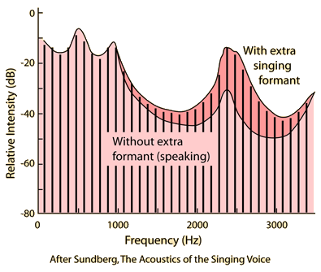
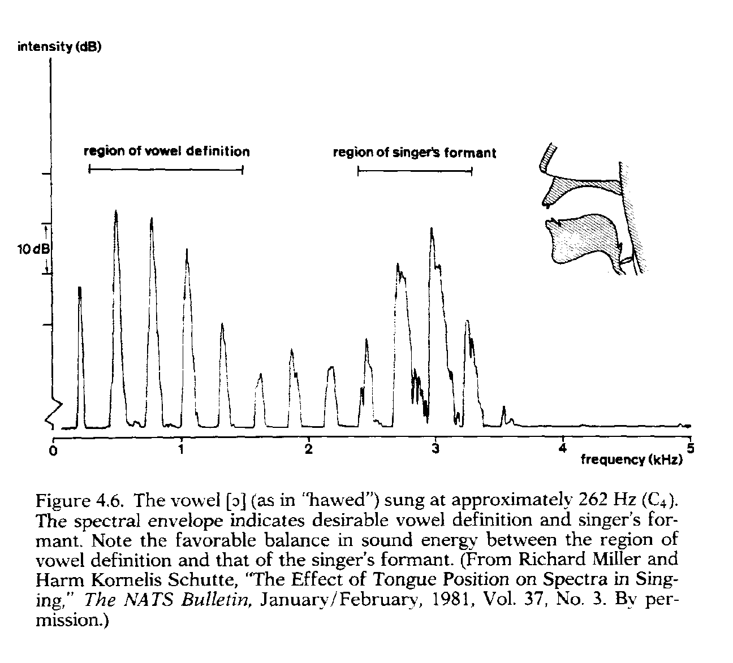
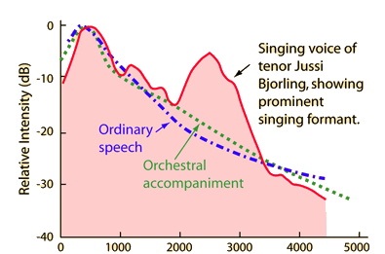
Formants
The singer’s formant is a skill developed by male singers to stand in front of the orchestra

Slide 11
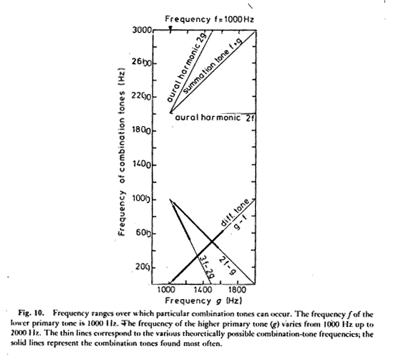
Combination of tones: Tartini tones
At loud and very loud levels, 2 tones that are close in frequency may create a “ghost” tone corresponding to the sum and to the difference (Tartini tone) of the frequencies
Other “extra” tones may also appear, all of them obbeying to a non-linear distortion process happening in the middle-ear or/and in the early auditory processing
https://www.animations.physics.unsw.edu.au/waves-sound/interference/#7.5

Slide 12
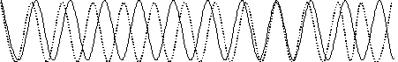
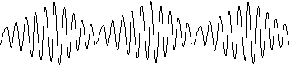
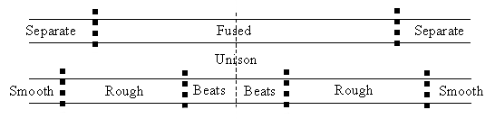
Combination of tones: Beating-Roughness
f₀-f₁<6Hz:
beating, single tone
f₀-f₁>24Hz & f₀/f₁<0.1:
roughness
CB
CB

Slide 13
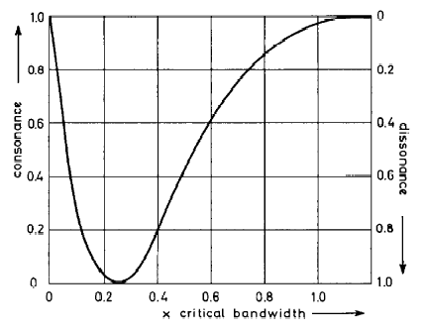
Combination of tones: Sensory consonance-dissonance
Consonance: ratio among their frequencies is a natural number or a simple fraction
Dissonance (ratios with non-natural numbers, e.g. 16:15 – minor second, 45:32 - tritone)

Slide 14
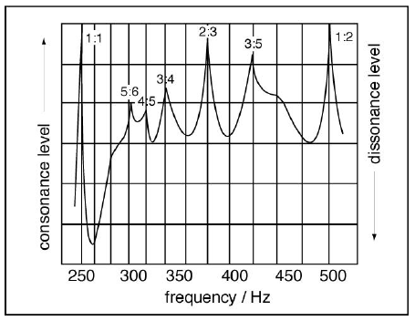
Combination of tones: Sensory consonance-dissonance
Highest consonances: obtained for unison and octave relationships (1:1, 1:2), fifth (2:3), Major sixth (3:5)
Lower consonances: are obtained for fourth (3:4), Major third (4:5), and minor third (5:6)
Minor second yields the lowest consonance
Other low-consonant combinations correspond to the minor ninth, Major and minor sevenths, tritone, and Major second
Sensory consonance as a function of the distance between partials. The frequency of the base tone is 250Hz (B3)

Slide 15
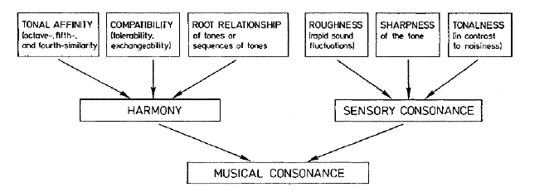
Sensory Consonance and Musical Consonance

Slide 16
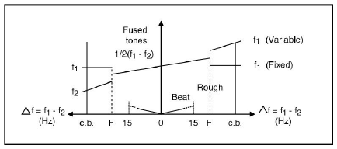
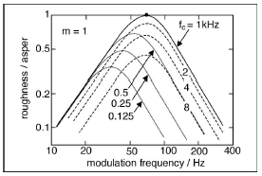
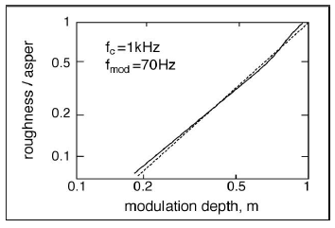
Roughness
Partials sharing a critical band but separated more than 15 Hz create a deep AM -> Roughness
Measured in asper
1 asper is the roughness generated by a 1 KHz tone at 60 phone, modulated at 70cps, full depth

Slide 17

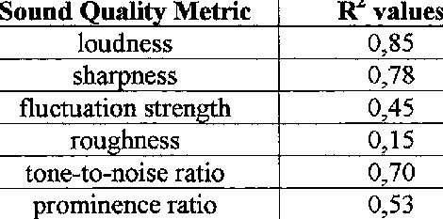
Fluctuation Strength
FS ~ Slow beating
Measured in vacils
1 vacil = a 1 kHz tone, fully modulated at 4 Hz, at a level of 60 phon
Fast beating (>20Hz) -> Roughness
Altınsoy, G. Kanca and H.T. Belek (1999) A comparative study on the sound quality of wet-and-dry type vacuum cleaners. Sixth International Congress on Sound and Vibration

Slide 18
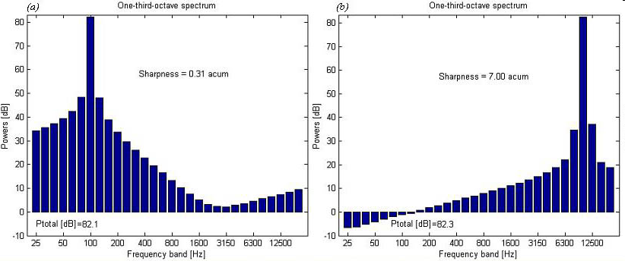
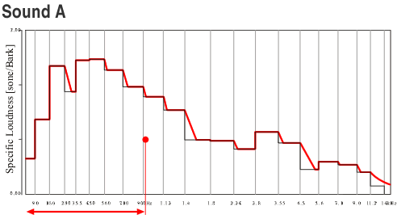
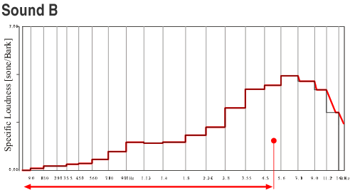
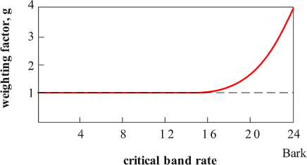
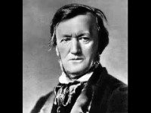
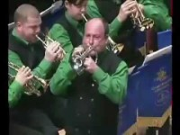
Sharpness
Sharpness = Brightness
Sensation related to the position of the spectral centroid, the gravity centre of the spectrum
Measured in acums
1 acum is the sensation generated by 1 Bark bandwidth noise, centered at 1kHz, at 60 phon.
Sharpness increases with frequency and with intensity
Trumpet dark (left) vs bright (right) sound

Slide 19
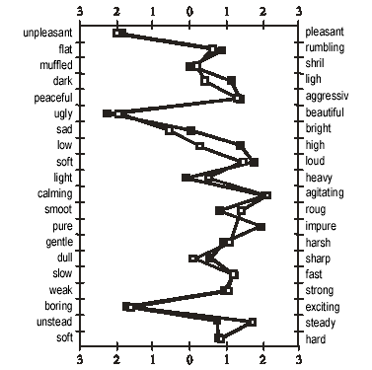
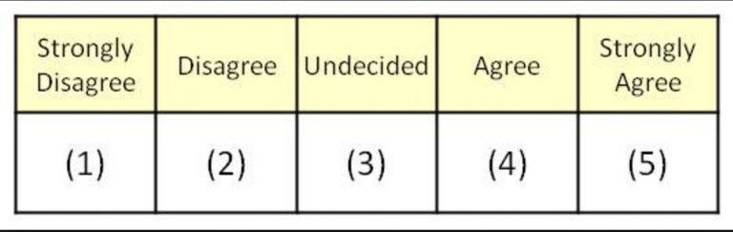
Sound description
Techniques
Rating scales/ Likert scales (how much the sound has some listed properties?)
Semantic differential (based on pairs of oposed adjectives; see right figure)
The most frequent adjectives are bright-sharp/dull-mellow, fast/slow, soft-rough

Slide 20
Use of timbre descriptors in applied contexts
Sound branding: giving a product a given quality that tells about a given status, power, functionality, etc.

Slide 21
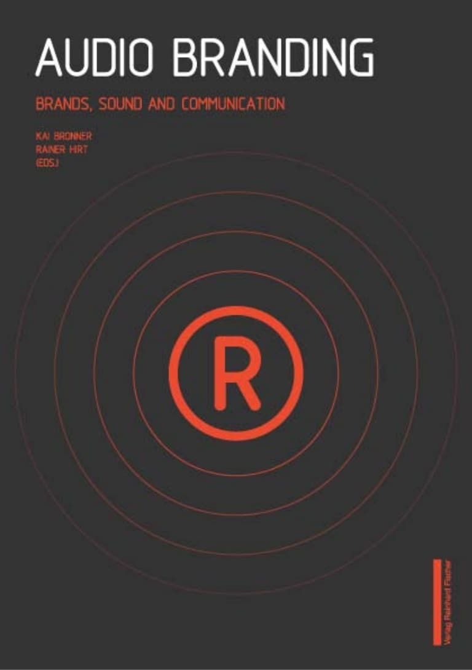
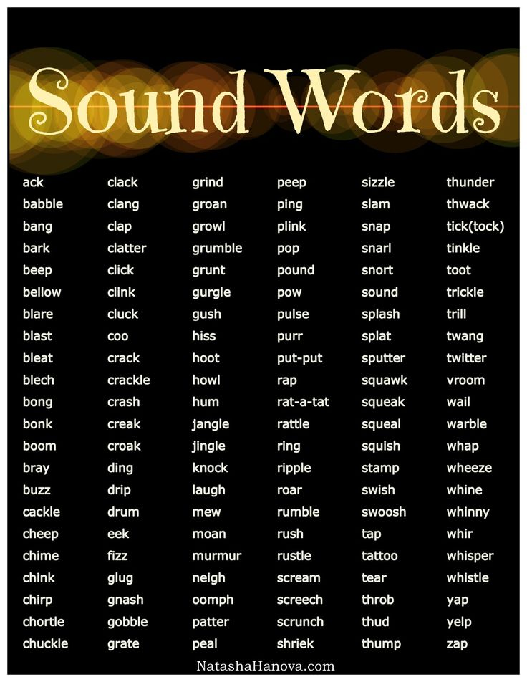
Use of timbre descriptors in applied contexts
http://recherche.ircam.fr/pub/timbretoolbox/timbretoolbox.zip

Slide 22
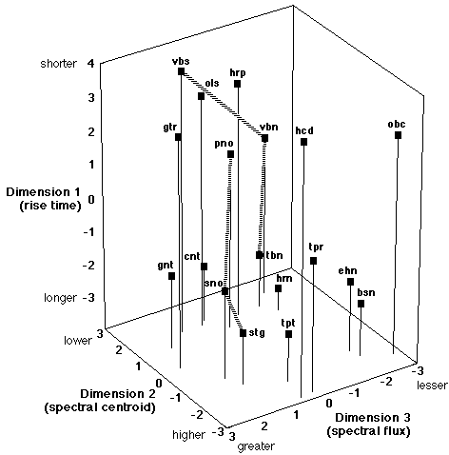
Timbre Spaces
Methodology:
Similarity judgments between pairs of sounds
Multidimensional scaling techniques
-> perceptual space
Audio analysis of the presented sounds
-> audio descriptors:
Rise time: time to reach maximum amplitude
Spectral centroid: gravity centre of the spectrum
Spectral flux: difference between the spectral energy in consecutive frames
Timbre space obtained by MacAdams et al. (1995). Some hybrid synthetic sounds were used (e.g. “sno” is a hybrid between bowed string and piano, “vbn” is hybrid between vibraphone and trombone)

